Slide 1
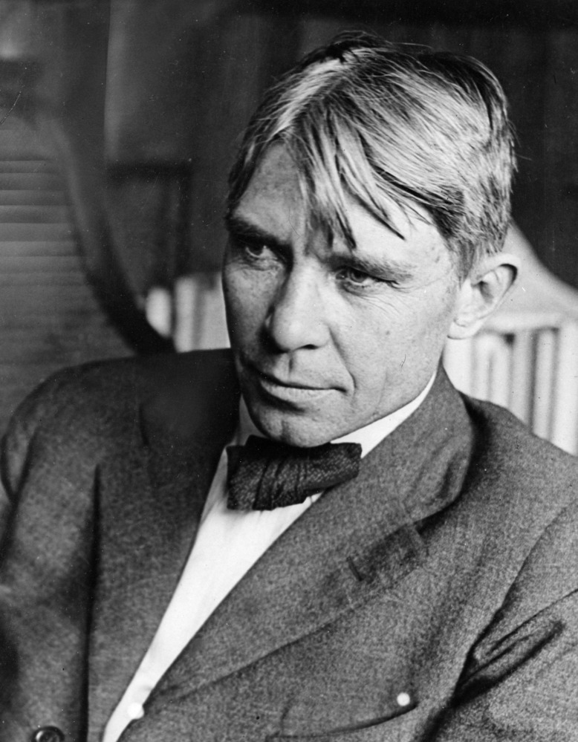
"Poet of the People“
Carl Sandburg provided a popular voice for the American people of the twentieth century and still speaks to us through his words, activism, music and the beauty and serenity of Carl Sandburg Home National Historic Site.
www.nps.gov/carl

Slide 2
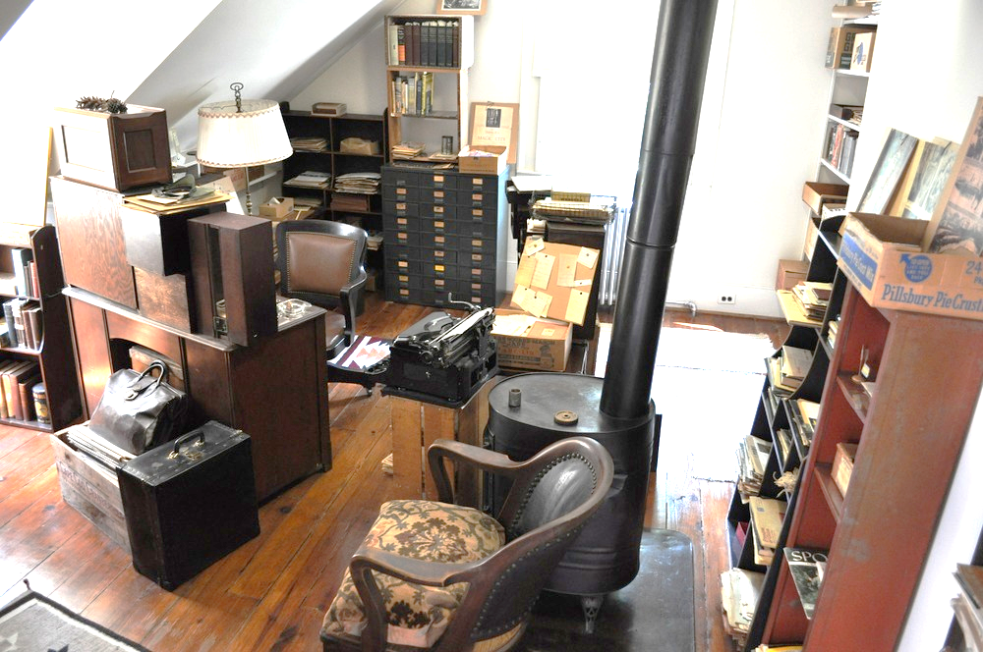
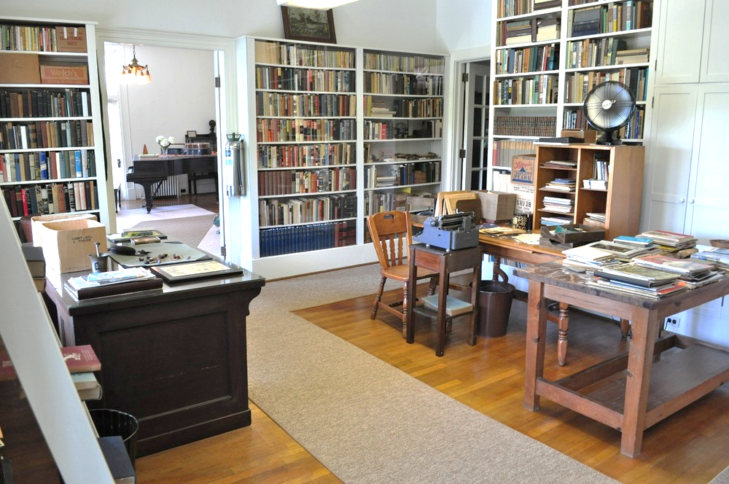
Carl Sandburg’s Connemara Grades K-2nd
Carl Sandburg lived at Connemara for the last 22 years of his life. What can you learn about Carl Sandburg based on the objects he had in his home?
Tasks:
1) Complete the activating strategy on slide 3. What does this object tell you about your teacher?
2) Watch the video on slide 4 to learn about Carl Sandburg’s Connemara. Make notes about what you see in the house.
3) Write to Explain what you learn about Carl Sandburg from an object that was important to him.

Slide 3
Look at the object below that your teacher picked. Then write your answer in the text box under the question.
What does the object tell you about your teacher?
Teacher will need to paste a picture of an object that is important to them.

Slide 4
Carl Sandburg’s Connemara
Click this link https://www.youtube.com/watch?v=jS0TJT6H_KE to learn about Carl Sandburg’s Connemara.
What objects do you see in Carl Sandburg’s home that you also have in your home? Why are those objects important?

Slide 5
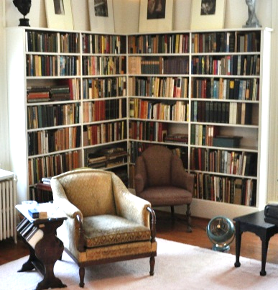
What can you learn about Carl Sandburg by the fact that he had more than 10,000 books in his house? What does this tell you about him?
In his autobiography “Always the Young Strangers,” Carl Sandburg wrote about being a young boy “I had books I didn’t have to take back to the Seventh Ward school or the Public Library…I was a book owner.” As an adult, Carl Sandburg had more than 10,000 books in his home.
Write your response here…

